Slide 1
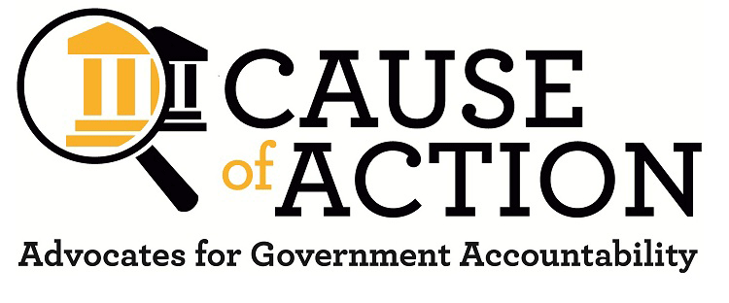
Transparency Tools Training: Making your job easier with open government
Daniel Epstein
Executive Director

Slide 2
Scholarly Concepts of Congressional Oversight
Congressional Oversight Overlooked: Police Patrols vs. Fire Alarms
(McCubbins and Schwartz 1984)
“Scholars have often remarked that Congress neglects its oversight responsibility. We argue that Congress does no such thing: what appears to be a neglect of oversight really is the rational preference for one form of oversight –– which we call fire-alarm oversight –– over another form –– police patrol oversight. Our analysis supports a somewhat neglected way of looking at the strategies by which legislators seek to achieve their goals.”

Slide 3
Police Patrol v. Fire Alarm
Police-patrol: “[A]t its own initiative, Congress examines a sample of executive-agency activities, with the aim of detecting and remedying any violations of legislative goals and, by its surveillance, discouraging such violations.”
Fire-alarm: “Congress establishes a system of rules, procedures and informal practices to enable individual citizens and organized interest groups to examine administrative decisions (sometimes in prospect) to charge executive agencies with violating congressional goals, and to seek remedies from agencies, courts and Congress itself.”

Slide 4
Considerations
Pre-Administrative Procedure Act Constitutional understanding of Oversight:
The Constitution provides for a Congress consisting of a Senate and House of Representatives and invests it with "all legislative powers" granted to the United States, and with power "to make all laws which shall be necessary and proper" for carrying into execution these powers and "all other powers" vested by the Constitution in the United States or in any department or officer thereof. Art. I, secs 1, 8. . . . But there is no provision expressly investing either house with power to make investigations and exact testimony to the end that it may exercise its legislative function advisedly and effectively. So the question arises whether this power is so far incidental to the legislative function as to be implied.
McGrain v. Daugherty, 273 U.S. 135, 160-61 (1927)

Slide 5
Effective Oversight
Are the documents requested already publicly available?
Agency reading rooms
FOIA online
MuckRock
Government Attic
Watchdog groups websites: CREW, CAGW, POGO, Sunlight

Slide 6
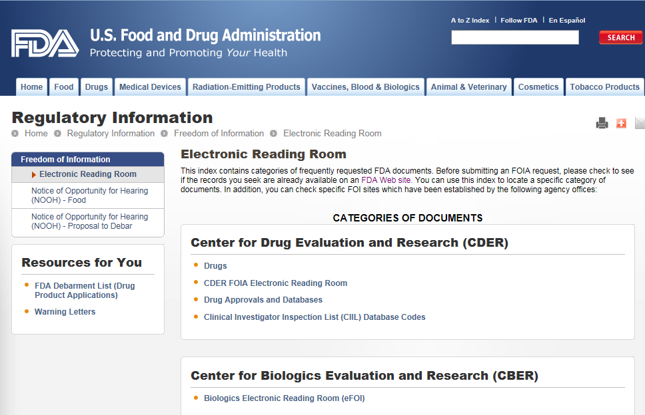
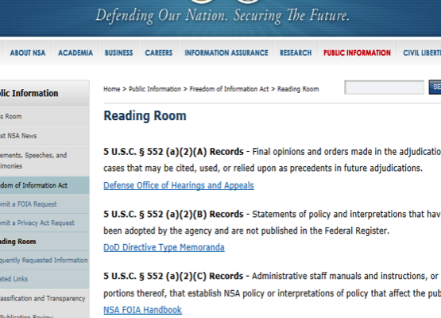
Agency Reading Rooms

Slide 7
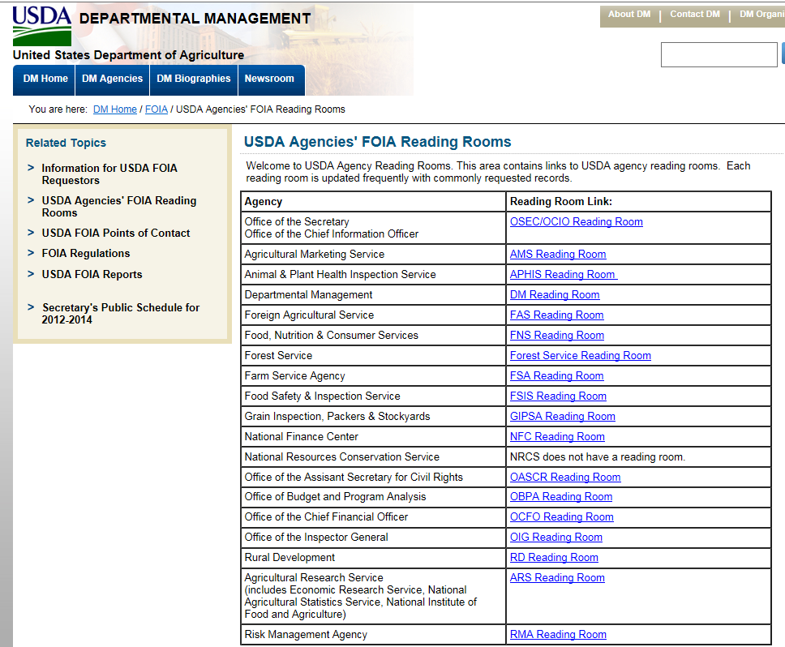
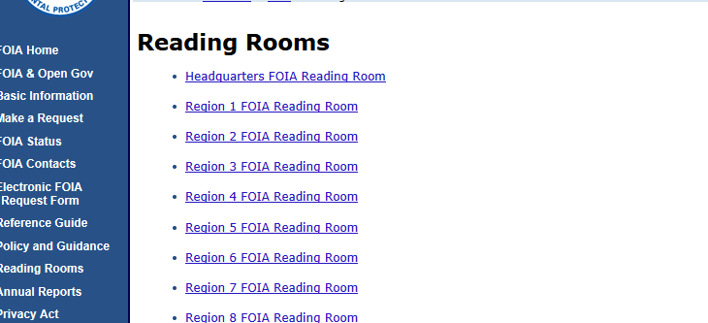
Agency Reading Rooms

Slide 8
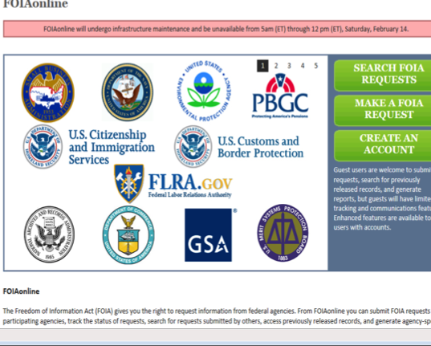
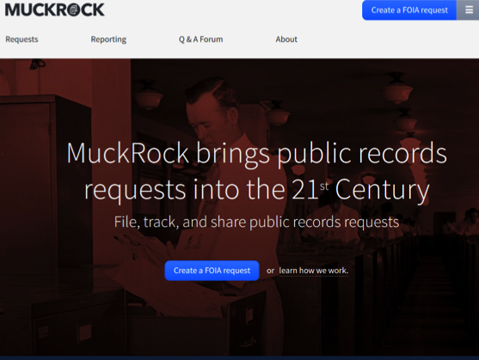
Publicly Available Sources

Slide 9
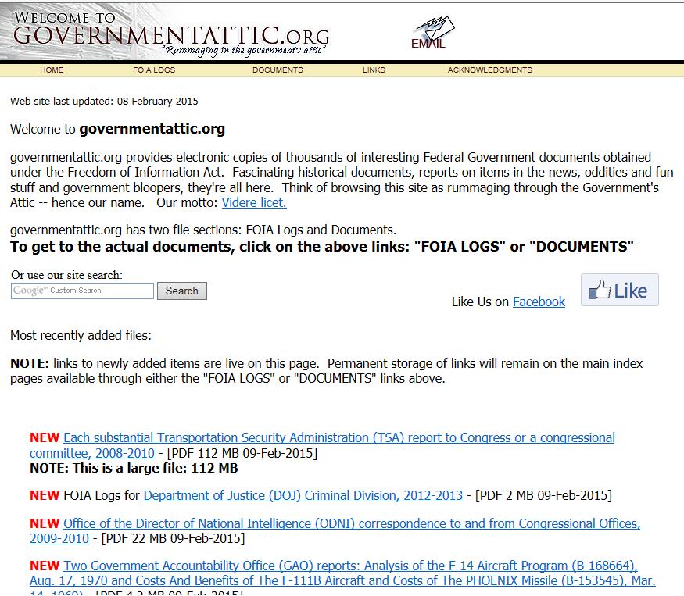
Publicly Available Sources

Slide 10
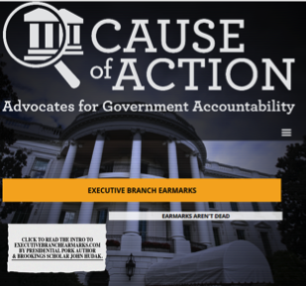
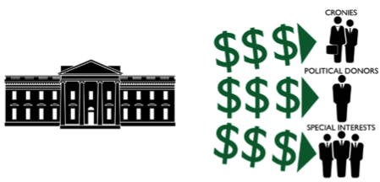
Effective Oversight
Have documents been posted online by watchdog groups?

Slide 11
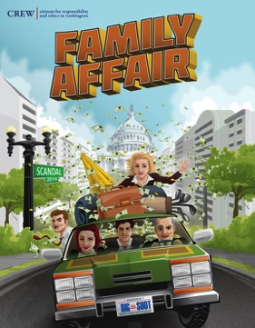
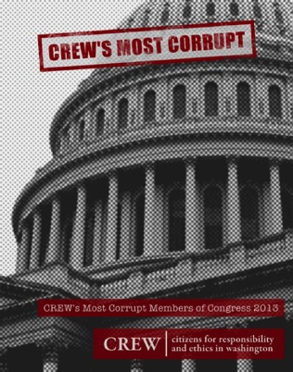
Effective Oversight
Have documents been posted online by watchdog groups?

Slide 12
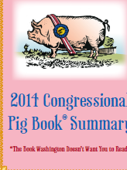
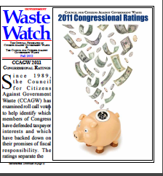
Effective Oversight
Have documents been posted online by watchdog groups?

Slide 13
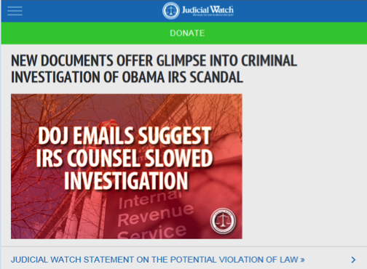
Effective Oversight
Have documents been posted online by watchdog groups?

Slide 14
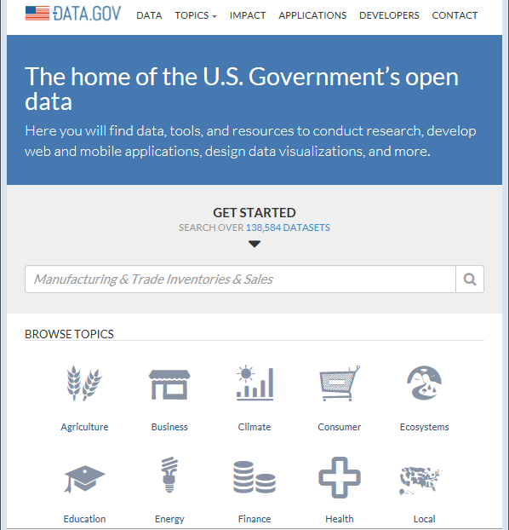
Effective Oversight
Have documents been posted online by Open Government Websites?

Slide 15
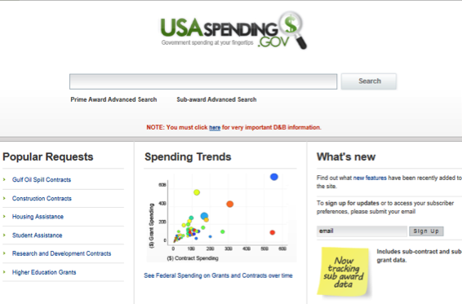
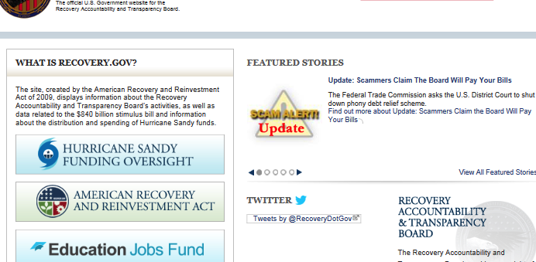
Effective Oversight
Have documents been posted online by Open Government Websites?

Slide 16
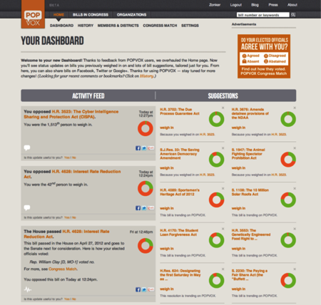
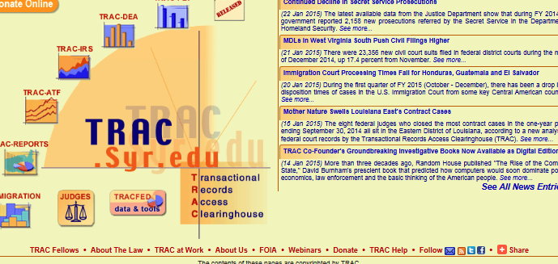
Effective Oversight
Have documents been posted online by Open Government Websites?

Slide 17
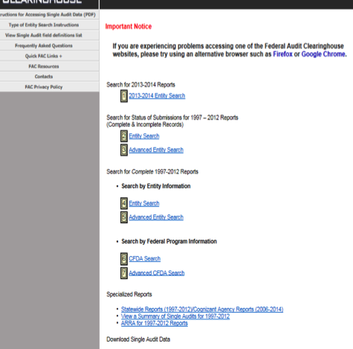
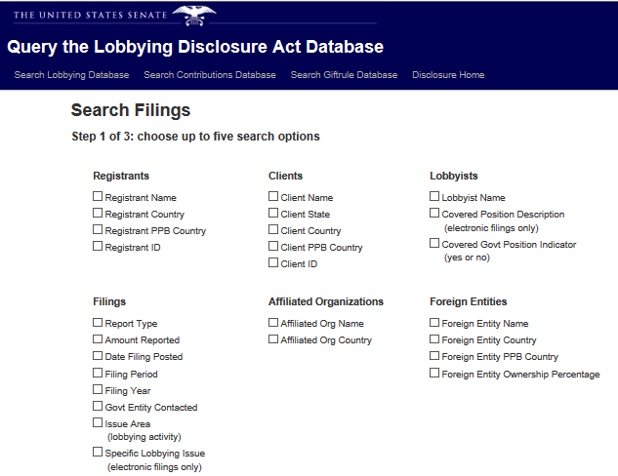
Federal Oversight Tools

Slide 18
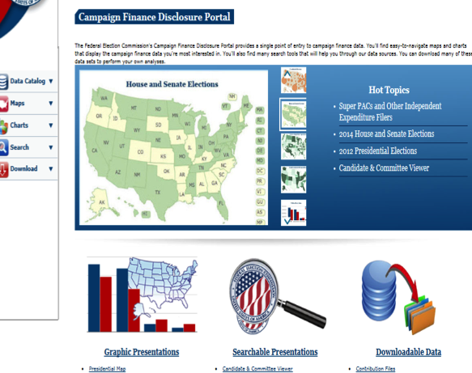
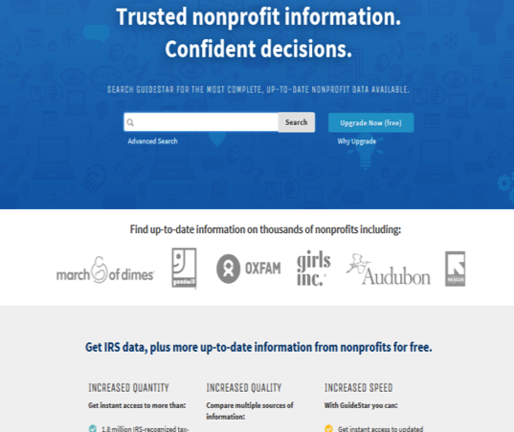
Federal Oversight Tools

Slide 19
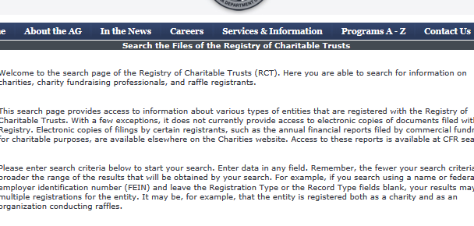
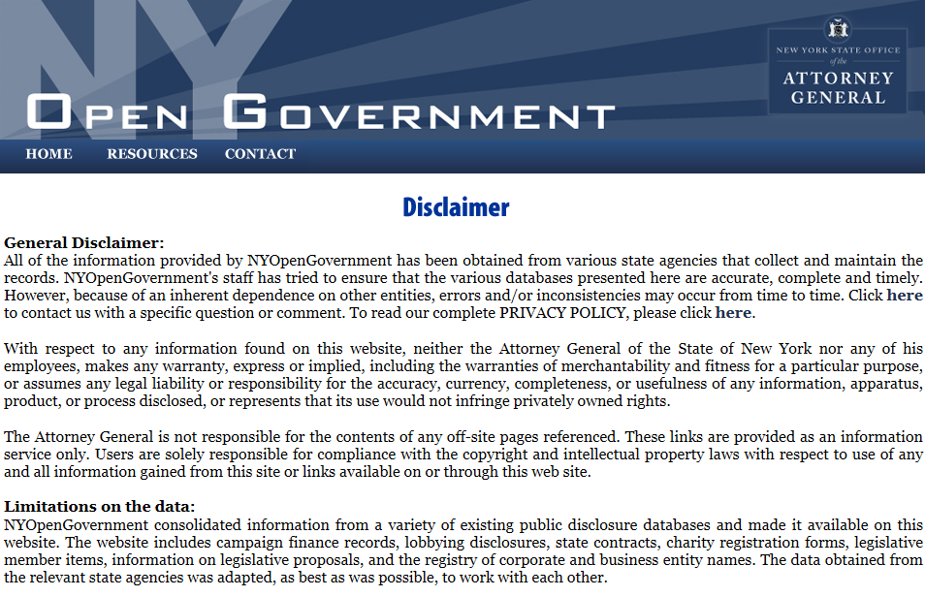
State Oversight Tools

Slide 20
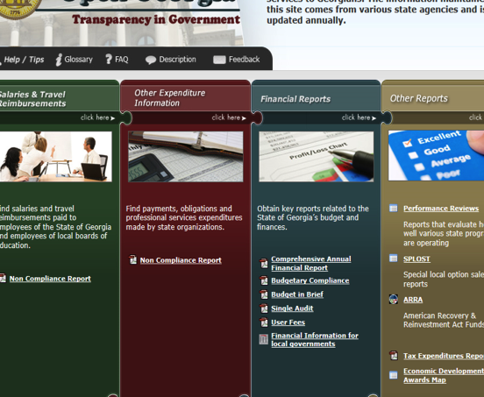
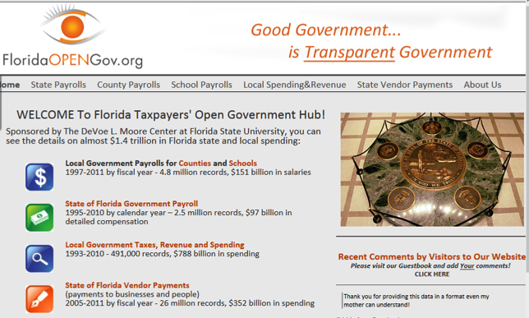
State Oversight Tools

Slide 21
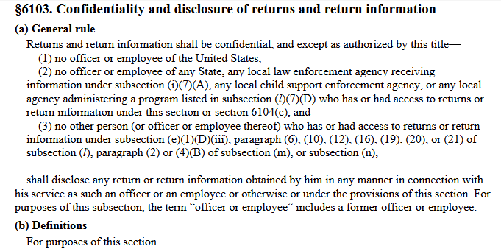
Effective Oversight
Some types of information can only be given to certain committees
Return information (§ 6103)

Slide 22
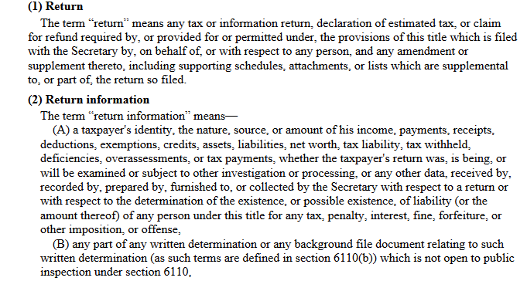
Effective Oversight
Some types of information can only be given to certain committees
Return information (§ 6103)

Slide 23
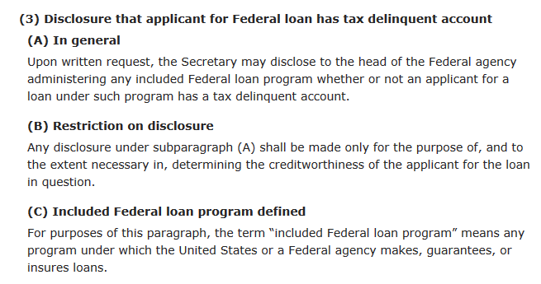
Effective Oversight
Ask different agencies for same type of documents

Slide 24
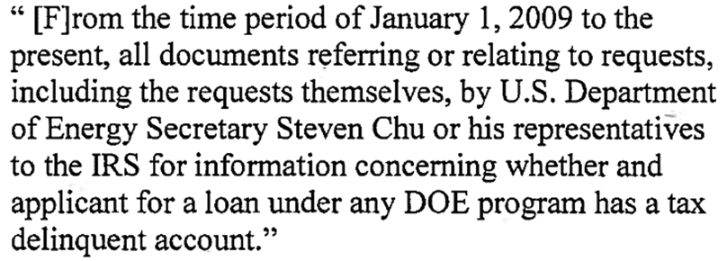
Effective Oversight
Ask different agencies for same type of documents

Slide 25
Effective Oversight
How do agencies define terms?

Slide 26
More info:
Cause of Action
www.causeofaction.org

